Slide 1
fITaURA agent
IBM AICTE PROJECT
Presented By:
Student name : ASHWINI R P
College Name & Department :
K.S. RANGASAMY COLLEGE OF TECHNOLOGY &
COMPUTER SCIENCE AND ENGINEERING

Slide 2
OUTLINE
Problem Statement
Technology used
Wow factor
End users
Result
Conclusion
Git-hub Link
Future scope
IBM Certifications

Slide 3
Problem Statement
In today’s fast-paced world, many individuals struggle to maintain a healthy lifestyle due to lack of personalized guidance, time constraints, and inconsistent motivation. Traditional fitness solutions often involve expensive subscriptions, rigid schedules, or in-person consultations that are not always accessible or adaptable to individual needs. As a result, users find it difficult to stay committed to regular workout routines, healthy eating habits, and long-term wellness goals.
Proposed Solution: Fitness Buddy is an intelligent, AI-powered virtual assistant designed to promote health and wellness by offering on-demand fitness advice, customized workout routines, daily motivation, and simple nutrition guidance. By understanding user preferences, lifestyle, and goals, the agent delivers personalized recommendations that support habit-building and long-term consistency. It serves as a friendly and always-available fitness companion, helping users stay active, eat better, and lead healthier lives.

Slide 4
Technology used
IBM cloud lite services
IBM Watsonx AI Studio
IBM Watsonx AI Runtime
IBM Granite model
Natural Language Processing (NLP)
Conversational AI using intent recognition and context tracking

Slide 5
IBM cloud services used
IBM Cloud Watsonx AI Studio
IBM Cloud Watsonx AI Runtime
IBM Cloud Agent Lab
IBM Granite foundation model

Slide 6
Wow factors
Acts as a 24x7 personal virtual fitness coach, accessible anytime and anywhere
Provides personalized workout and meal recommendations based on user input
Motivates users with daily fitness quotes, habit tips, and goal tracking
Encourages consistency through reminders, progress checks, and interactive feedback
Voice/chat-based interface that feels like chatting with a real fitness coach
Supports home workouts without the need for equipment or gym subscriptions
Adaptive plans that evolve with user performance and changing preferences
Enhances user commitment through streak tracking and achievement badges

Slide 7
End users
Working professionals
Students
Elderly population
Fitness enthusiasts
People with time/space constraints
Beginners looking to get fit

Slide 8
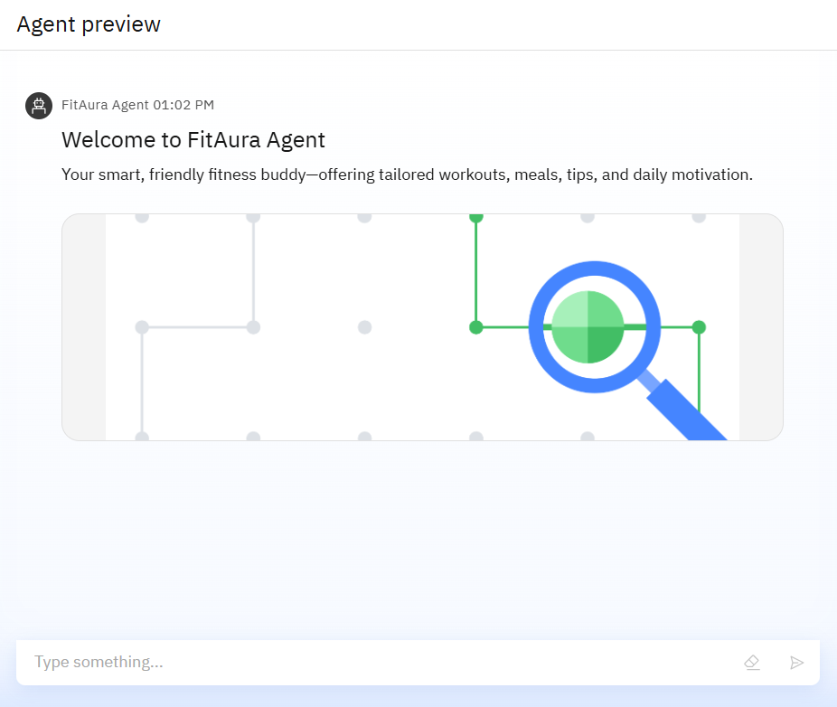
Results

Slide 9
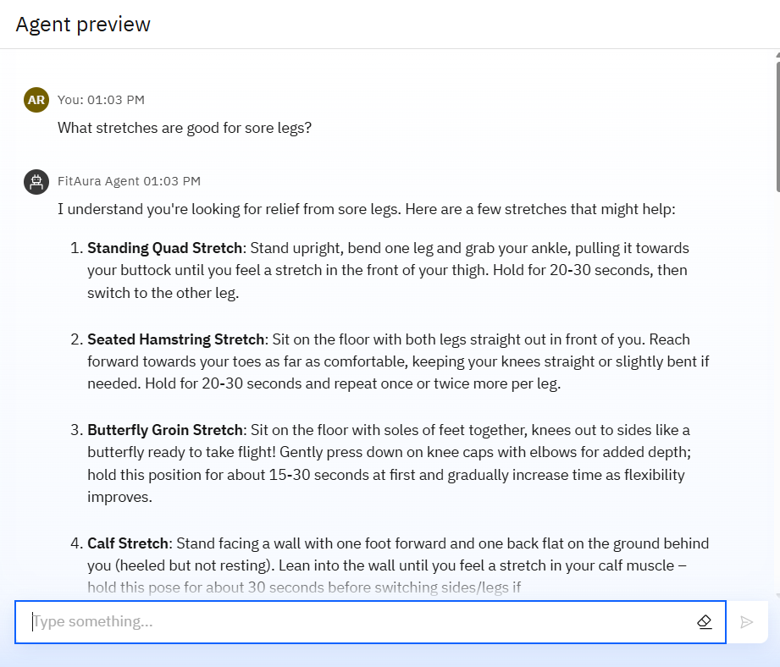
Results

Slide 10
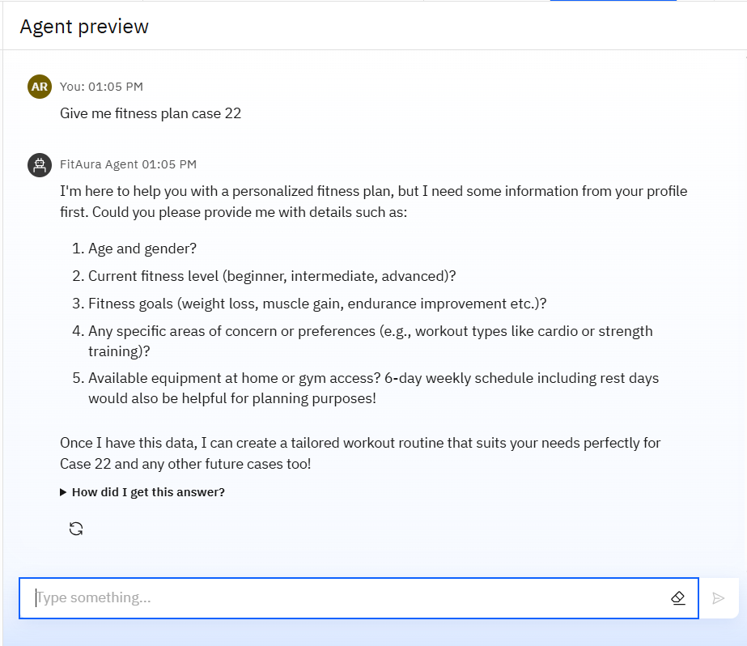
Results

Slide 11
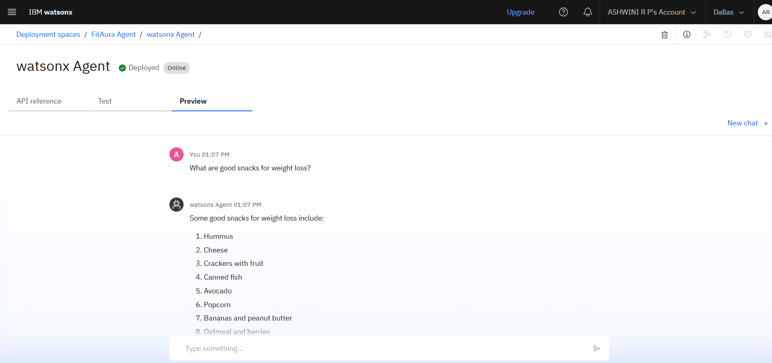
Results
Deployed AI Agent

Slide 12
Conclusion
AI agent offers scalable and accessible fitness solutions
AI agent offers scalable and accessible fitness solutions
Encourages users to adopt a healthier lifestyle
Reduces reliance on expensive fitness subscriptions
Available anytime, on-demand, and tailored to user goals

Slide 13
Voice-based interaction for accessibility
Future scope
Integration with wearables (Fitbit, Apple Watch)
Voice-Activated Research Assistant
Mental wellness & meditation features
AI-based progress analytics and insights
Personalized injury prevention programs
Social features like group challenges

Slide 14
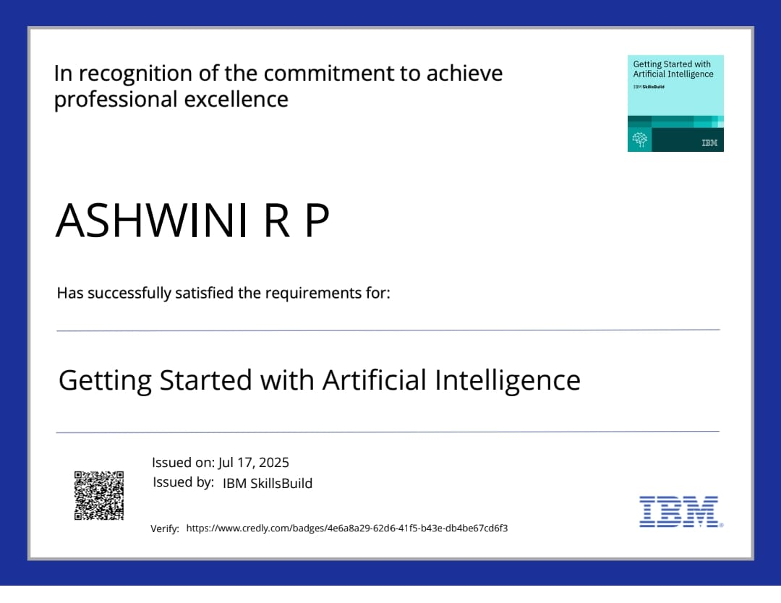
IBM Certifications

Slide 15
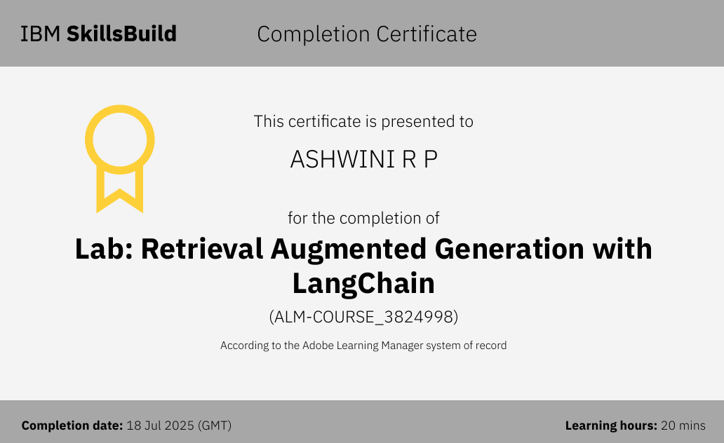

Slide 16
GitHub Link

Slide 17
THANK YOU

